Slide 1
Obesity Levels Prediction
Daud Rusyad Nurdin
DA/DS Bootcamp batch 34
Check-Point 1

Slide 2
Table of Contents
01
Data Understanding
02
03
Exploratory Data Analysis (EDA)
Data Prepocessing
04
Conclusions
2
00
Objectives
the objectives of this final project
the process of exploring, describing, and assessing data to gain insight into its structure, quality, and relevance for the problem being solved.
the process of summarizing and visualizing data to uncover patterns, relationships, and anomalies.
the process of cleaning, transforming, and organizing raw data to prepare it for modeling or analysis
05
Next Plan
Summary of the discussion that has been presented
Machine Learning Modelling and
to develop a Streamlit-based application for predicting obesity levels

Slide 3
Objectives
To conduct an in-depth exploration of the obesity level dataset in order to identify and analyze the key factors that significantly influence an individual's level of obesity.
To develop and evaluate various machine learning models with the aim of determining the most accurate and reliable model for predicting obesity levels based on the given features.
To design and implement an interactive Streamlit-based application that integrates the selected machine learning model to predict an individual's obesity level according to user-provided input parameters.

Slide 4
01
Data Understanding

Slide 5
Data Structure
Source File
Source Link
5
ObesityDataSet_raw_and_data_sinthetic.csv
https://archive.ics.uci.edu/dataset/544/estimation+of+obesity+levels+based+on+eating+habits+and+physical+condition

Slide 6
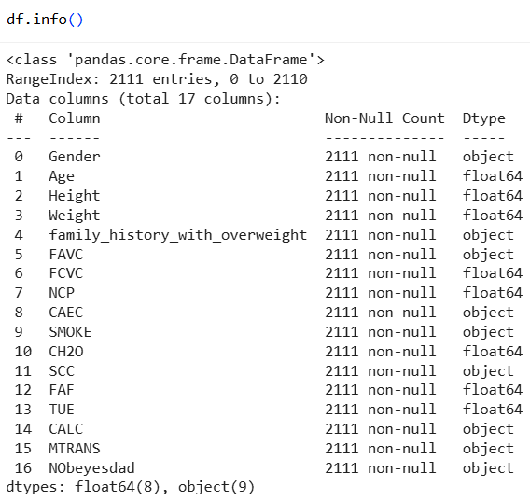
General Info
6
Categorical
Numerical
Gender
FHWO
FAVC
CAEC
SMOKE
SCC
CALC
MTRANS
NObeyesdad
Age
Height
Weight
FCVC
NCP
CH2O
FAF
TUE
features
None of columns contains null values → no imputation required
target

Slide 7
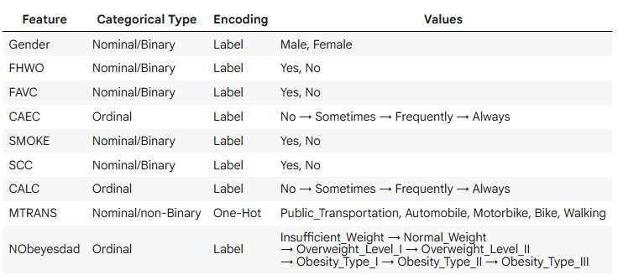
Categorical Column Types
7

Slide 8
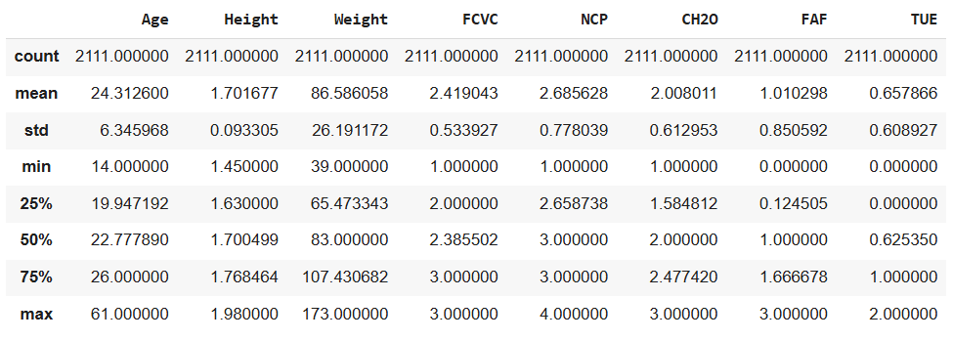
General Statistic
8

Slide 9
02
Exploratory Data Analysis (EDA)

Slide 10
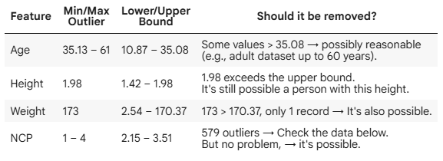
Data Quality
10
Missing Values | Duplicate | Outliers
None | 24
No imputation
Drop duplicate rows
No need to remove outliers

Slide 11
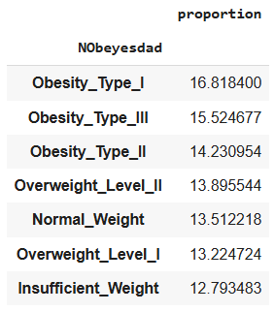
Checking data balance relative to target…
11
The data is relatively balanced across target levels → no data resampling required

Slide 12
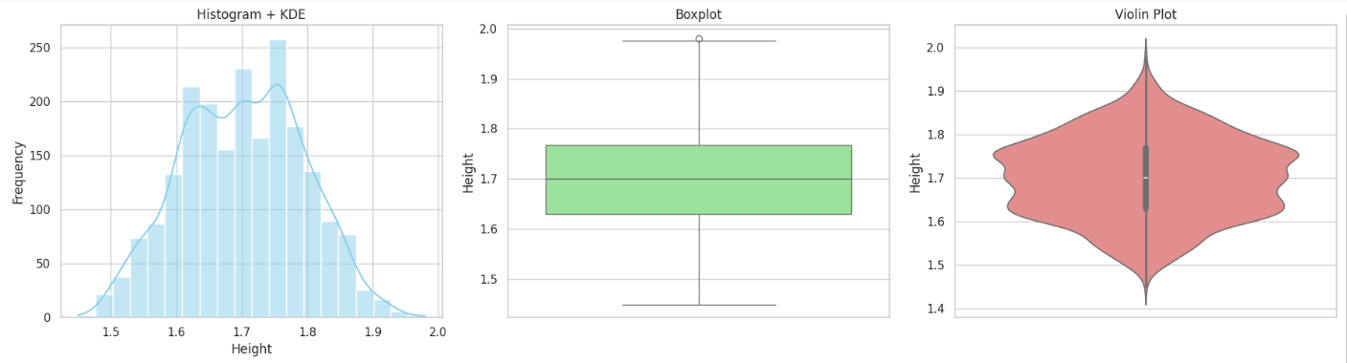
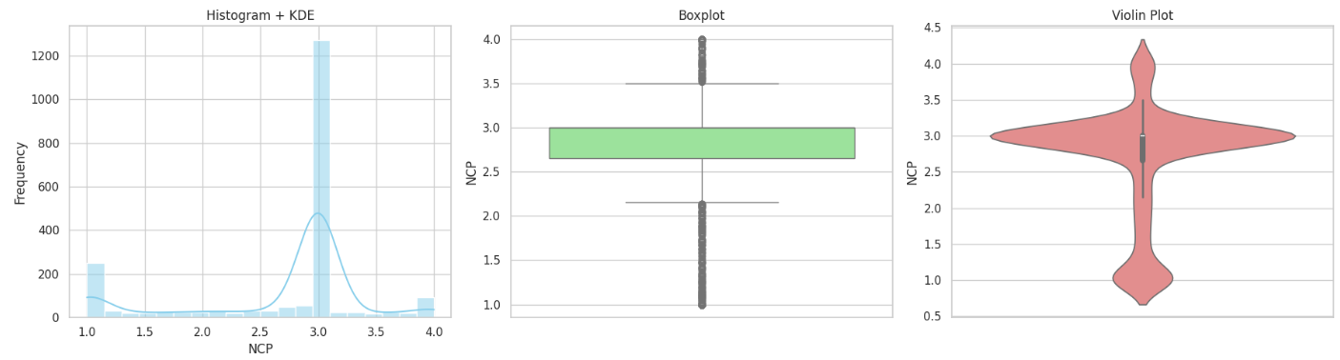
Data Distribution and Outliers Diagram
12

Slide 13
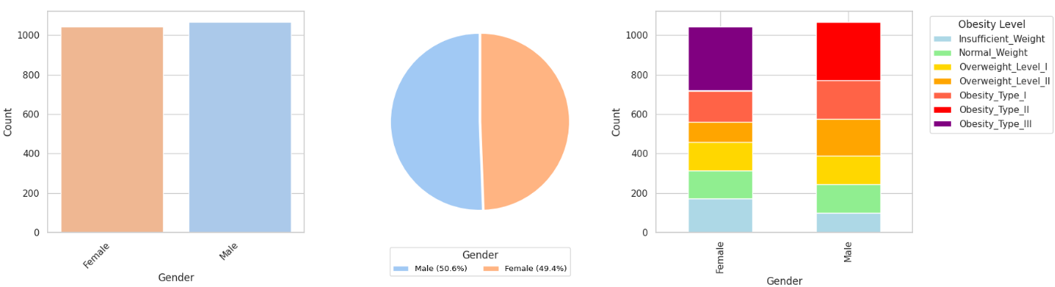
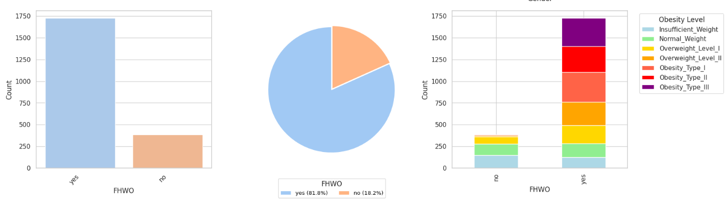
Factors Influencing Obesity Levels
13

Slide 14
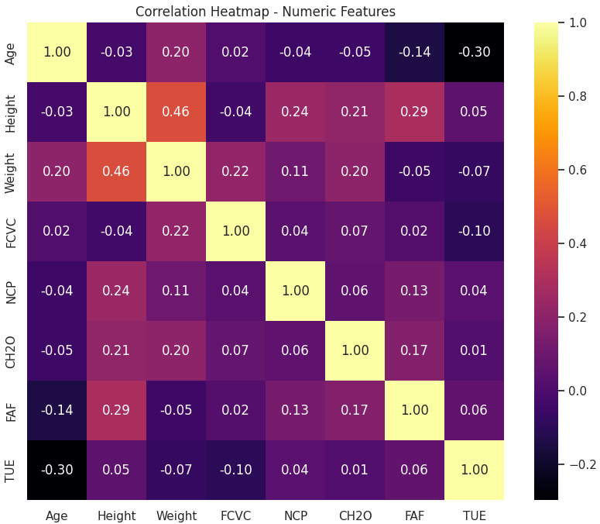
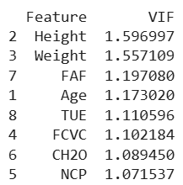
Corr Heatmap and VIF Score: Numerical Features
14
There is no indication that any of the features contain multicollinearity.

Slide 15
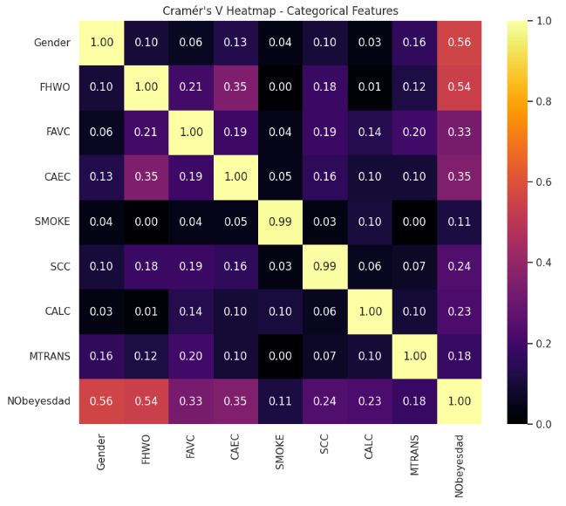
Cramér’s V Heatmap: Categorical Features
15
There is no indication that any of the features contain multicollinearity.

Slide 16
03
Data Prepocessing

Slide 17
Pipeline
Data Duplicate
Data Selection
Data Scaling
Data Splitting
Data Encoding
17
Drop 24 rows duplicate data
None - No multicollinearity was detected
Using Standard Scaller
1
2
3
4
5
Train : Test
80 : 20
8 : Label encode
1 : One-Hot encode

Slide 18
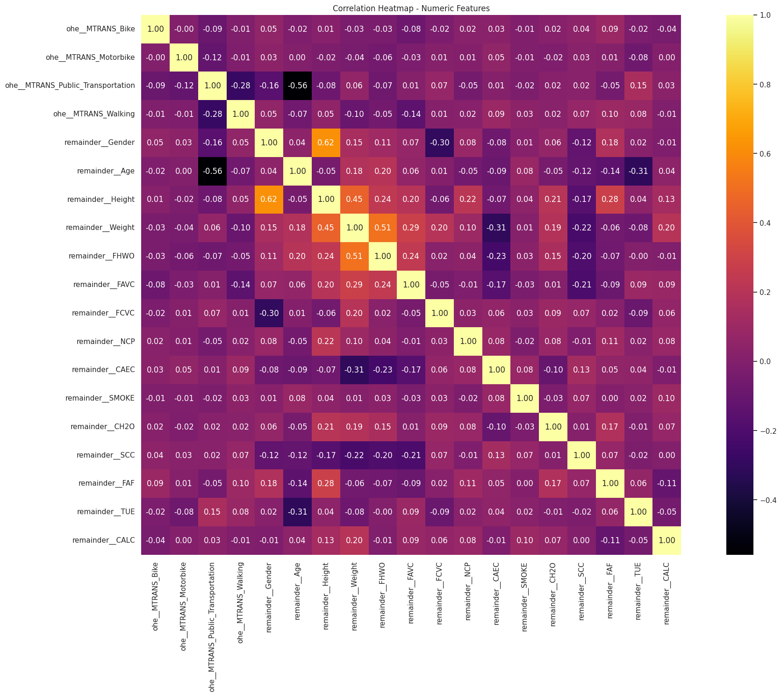
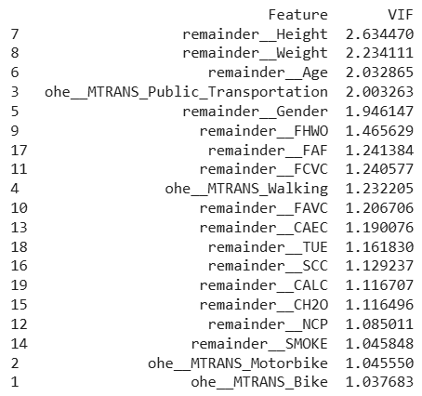
Corr Heatmap and VIF Score: After Scaling
18
There is no indication that any of the features contain multicollinearity.

Slide 19
Conclusions
19
Data Size: Small – Medium (2111 rows minus 24 duplicate, 17 columns: 16 features, 1 target.
Missing Values: No missing values → No imputation required
Duplicates: 24 duplicate rows found → Drop duplicate data
Outliers: Outliers are meaningful → No need to remove outlier data
Multicollinearity: No multicollinearity detected → No feature selection required
Class Balance: No resampling performed as data is relatively balanced against the target variable
Encoding: 9 categorical columns were encoded (label = 8, one-hot=1)
Scaling: Applied for models using distance-based calculations, while tree-based models did not require scaling

Slide 20

Next plan…
Modeling
20
Model | Category | Scaling?
Logistic Regression | Linear | Yes
Ordinal Logistic Regression | Linear | Yes
Random Forest | Tree-based | No required
XGBoost Classifier | Tree-based | No required
LightGBM Classifier | Tree-based | No required
CatBoot Classifier | Tree-based | No required
Develop Application
To build a Streamlit application that implements a selected model for predicting obesity levels from user-input parameters.

Slide 21
Thank you!

